Slide 1
Cloud Concierge Program Platform for POC & DEMO’s
Notes:
Updated January 2017
Ivan Aguilera aguileri@us.ibm.com

Slide 2

What is Cloud Concierge

Slide 3
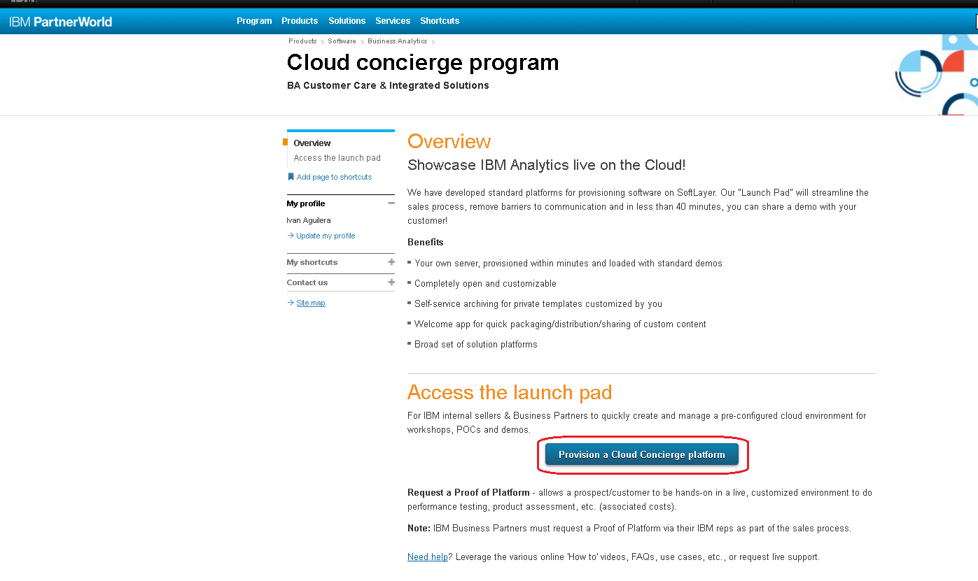

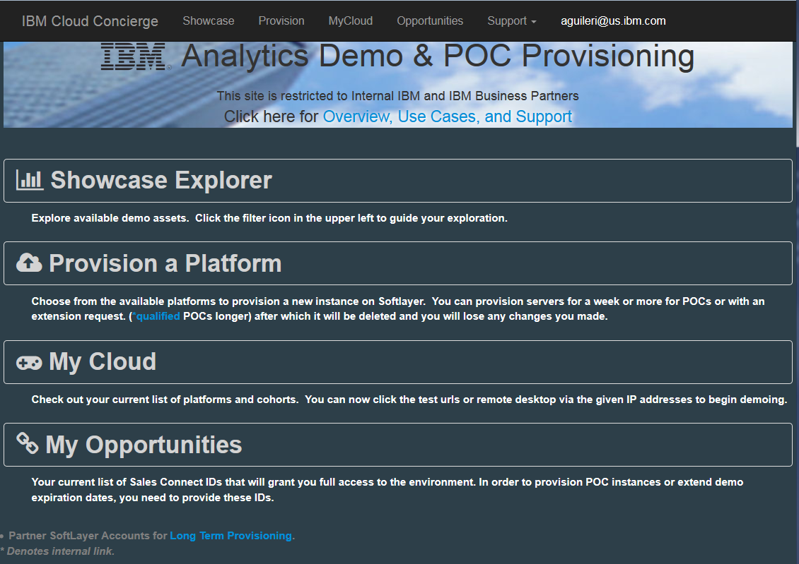
Providing you with a technology platform to showcase our solutions on the Cloud.
What does this mean?
We have a launch pad, available for partners and IBMers, that streamlines the process and remove barriers to support our field teams as we scale our SaaS offerings by offering standard platforms for provisioning our solutions on SoftLayer. Regularly available in less than 40 minutes you can have a demo environment to show or even share with your customers.
What’s the benefit
Internal IBM & Partner access
Easily share cloud based live Demo’s with customers
Extended Demo Capability
Ideal for Mobile demos
Support structure around the Cloud Concierge Program comprised of technical assistance and advocates
Vastly improved agility to provide latest updates
SoftLayer

Slide 4
Demonstrating using Cloud image
Cloud Software Hosted in Cloud Outside of Firewall
Web Provisioning Application
Short & Long Term Scheduling
Cognos Analytics, Planning Analytics
BBCI , Big Insights
IIS, ECM, Etc.…
SoftLayer

Slide 5
Some of the available Environments in Cloud Concierge … check back often as they are constantly being added and/or updated
Industry Solutions | FSS B2B Attrition Demo | FSS,SPSS,Cognos | 1.0.0 | 27-Jan-17
BA | CPLEX Optimization Studio Developer 12.7 | CPLEX | 12.7 | 25-Jan-17
Asset Management | Maximo-7.6.0.6-AssetHealthInsights-7.6.0.1_R1 | Maximo | 7.6.0.6 | 25-Jan-17
BigData | Streams 4.2 V1R4 | Streams | 1.4 | 25-Jan-17
Data Movement,Governance | MDM SE/AE V11.5 FP3 Demo Image V4.6 | MDM | 4.6 | 23-Jan-17
BigData | BigInsights 4.2 Single Node V1R7 | BigInsights,Zeppelin,SPSS Analytic Server | 1.7 | 22-Jan-17
Data Movement,Governance | MDM SE/AE V11.6 Demo Image V0.5 | MDM | 0.5 | 22-Jan-17
BA | Planning and Optimization 2.12 | TM1,Planning Analytics,CPLEX | 1 | 20-Jan-17
BA | Decision Optimization Support for Fab Assembly Line | Decision Optimization Center | 3.9 | 17-Jan-17
Data Movement,Governance | IIDR CDC (IBM Data Replication) | IIDR CDC | V1R4 | 17-Jan-17
Data Movement,Governance | IIS on Cloud DQ - Client | Information Server,IIS | 11.5.0 | 17-Jan-17
Data Movement,Governance | IIS on Cloud EE - Client | Information Server,IIS | 11.5.0 | 17-Jan-17
BA | Decision Optimization Center Developer 3.9 | Decision Optimization Center | 3.9 | 16-Jan-17
Data Movement,Governance | IGC on Cloud Cluster | Information Server,IIS,IGC | 11.5.0 | 16-Jan-17
Data Movement,Governance | IIS on Cloud Data Quality Cluster | Information Server,IIS,DQ | 11.5.0 | 16-Jan-17
Data Movement,Governance | IIS on Cloud EE Cluster | Information Server,IIS,EE | 11.5.0 | 16-Jan-17
Base Image | Base Image - Windows 2012 with DB2 10.5.6, and WAS 8.5.5.7 | DB2,WAS,Base Image | 2012 | 12-Jan-17
ECM | Case Manager 5.3 and Datacap 9.0.1 Showcases | ECM,Case,Datacap | 4.1M | 12-Jan-17
FPM | FPM+ Enterprise Platform V1.6 | Controller,CDM,Cognos,TM1 | 10.3 | 12-Jan-17
BA | Predictive Forecasting (German) | TM1,Planning Analytics,SPSS | 1 | 12-Jan-17
Continuous Engineering | IoT CE 6.0.3 V0.1 | Jazz,Rhapsody,DOORS | 6.0.3, 8.2, 9.6.1.7 | 11-Jan-17
Data Movement,Governance | IGC on Cloud - Client | Information Server,IIS | 11.5.0 | 10-Jan-17
Data Movement,Governance | IGC on Cloud - Server | Information Server,IIS | 11.5.0 | 10-Jan-17
Data Movement,Governance | IIS on Cloud DQ - Engine | Information Server,IIS | 11.5.0 | 10-Jan-17
Data Movement,Governance | IIS on Cloud DQ - Services/Repository | Information Server,IIS | 11.5.0 | 10-Jan-17
Data Movement,Governance | IIS on Cloud EE - Engine | Information Server,IIS | 11.5.0 | 10-Jan-17
Data Movement,Governance | IIS on Cloud EE - Services/Repository | Information Server,IIS | 11.5.0 | 10-Jan-17
Continuous Engineering | IoT CE 6.0.2 DM Masterclass | Jazz,Rhapsody,DOORS | 6.0.3iFix1, 8.2iFix1, 9.6.1.7 | 9-Jan-17
BA | FOPM Planning Analytics BETA v2.5 | TM1,Planning Analytics | 2 | 5-Jan-17
BA | FOPM Planning Analytics GA v1.14 | TM1,Planning Analytics | 10.3 | 5-Jan-17
BA | Decision Optimization Center Developer 3.8.0.2 | Decision Optimization Center | 3.8.0.2 | 27-Dec-16
FPM | German Public Sector Demo | TM1,CDM | 1.0.2 | 27-Dec-16
FPM | FPM+ Enterprise Platform V1.5 | Controller,CDM,Cognos,TM1 | 10.2.2 | 21-Dec-16
Watson Explorer | Watson Explorer Analytical Components V11 | Watson Explorer | 11 | 21-Dec-16
Data Movement,Governance | Identity Insight 8.1.0.4 | Identity Insight | 8.1.0.4 | 20-Dec-16

Slide 6
Registering and Login into CC

Slide 7
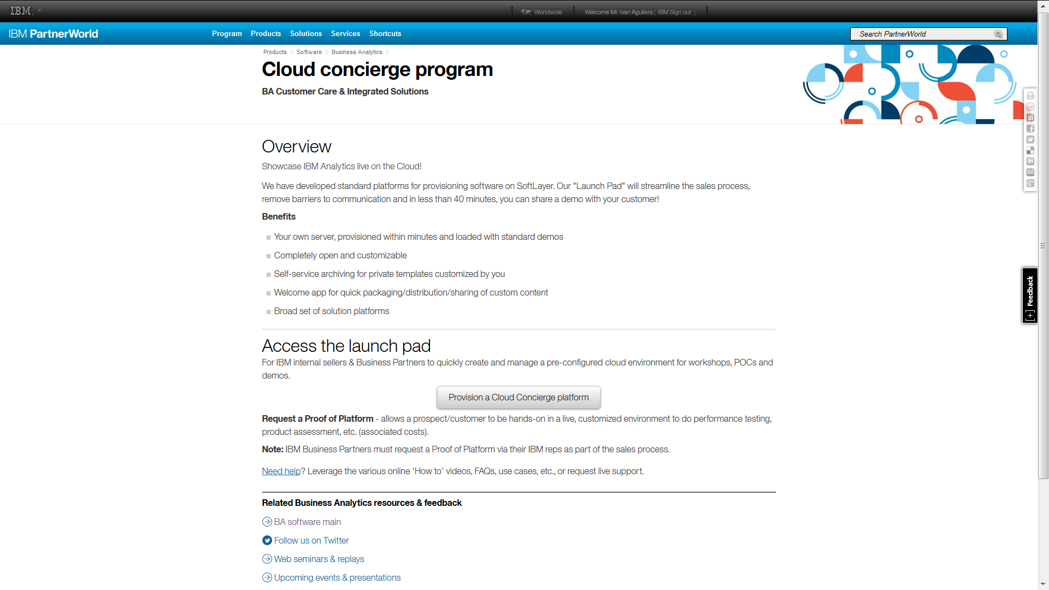
https://www-304.ibm.com/partnerworld/wps/servlet/mem/ContentHandler/pw_com_sfw_ba-cloud_concierge?cmrec=recommendations
Partners have access to the Cloud Concierge offering through PW on the website below:

Slide 8
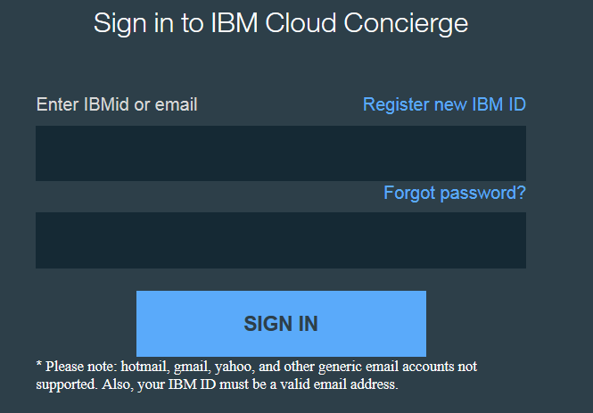
Or by going directly to :
https://demo.ibmcloud.com/DC3KWEB/Account/Login

Slide 9
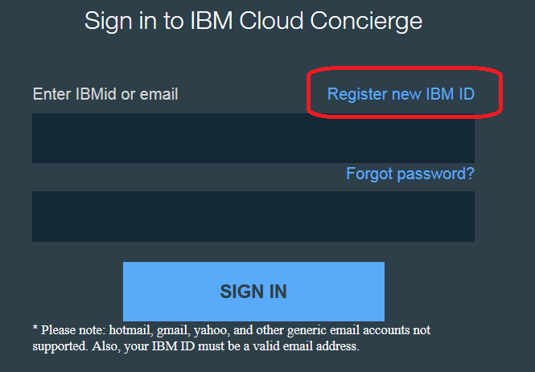
Partner logs in with their IBM id credentials … NEEDS to be company’s EMAIL ADDRESS (could be the same user and password they use for PW if in email address form). IBMers MUST use your IBM email address, if your IBM ID is different you may create a new IBM ID just for this service using your IBM email, you will not be automatically authorized you must request access by sending an email to askibmst@ca.ibm.com
You can also Register if you don’t have an IBM id… Please note the GENERAL restrictions when creating your USER (NO emails that don’t reflect a company)

Slide 10
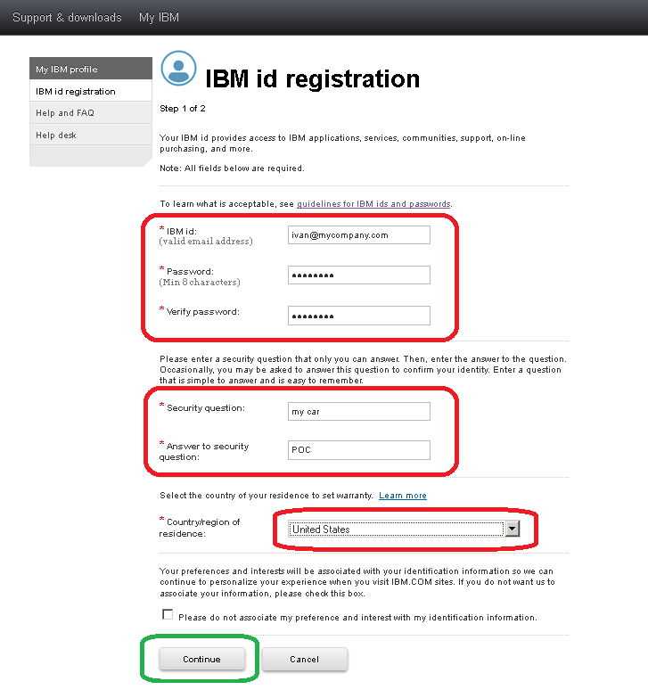
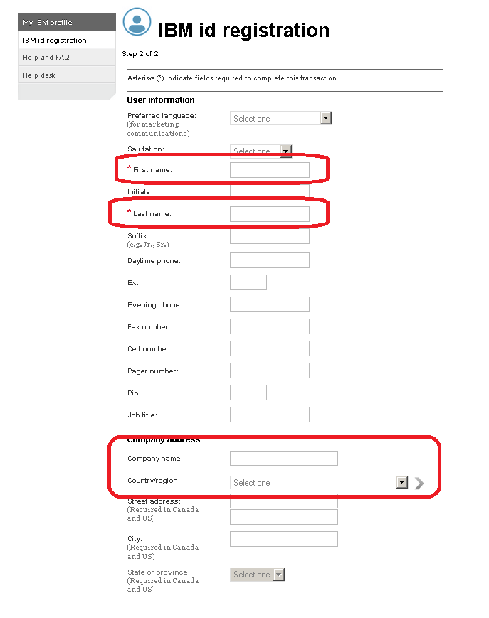
Registration process is simple if needed …

Slide 11
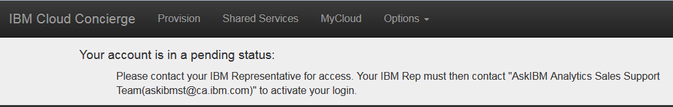
First time a BP registers they get a message stating pending status …
MUST follow the instructions on this message above, account activation is NOT AUTOMATIC

Slide 12
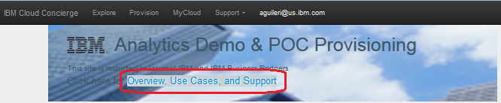
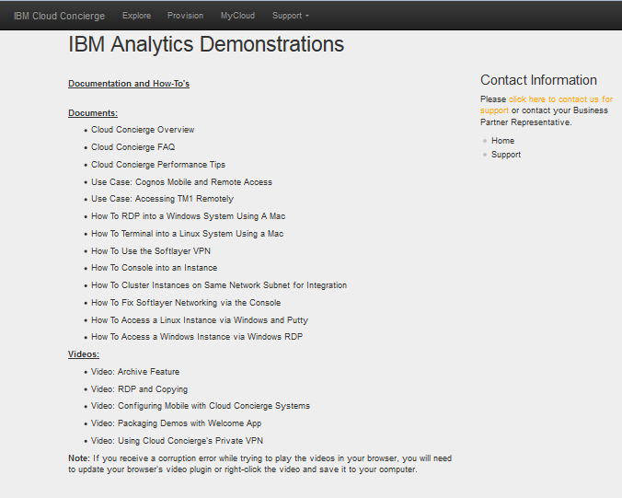
Please review and download word docs, ppts and videos found under this highlighted link
It is very likely your questions are already answered on these documents and/or explained in a video

Slide 13
If you are looking for LONG TERM provisioning

Slide 14
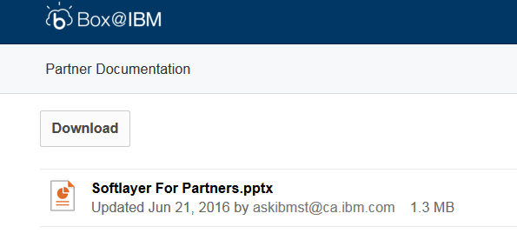
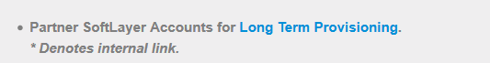
Once logged into the main page, download the ppt that explains in detail what you can do if you have your own SoftLayer account

Slide 15
Exploring the available assets

Slide 16
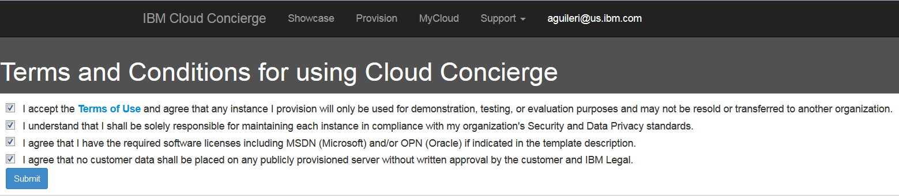
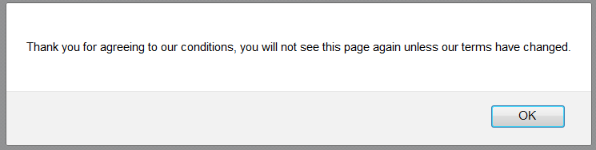
First time you log in … you must accept these conditions

Slide 17
Once logged in … you are presented with these 4 options

Slide 18
If you are not familiar with the images available use the new Showcase Explorer option to easily find the asset you need

Slide 19
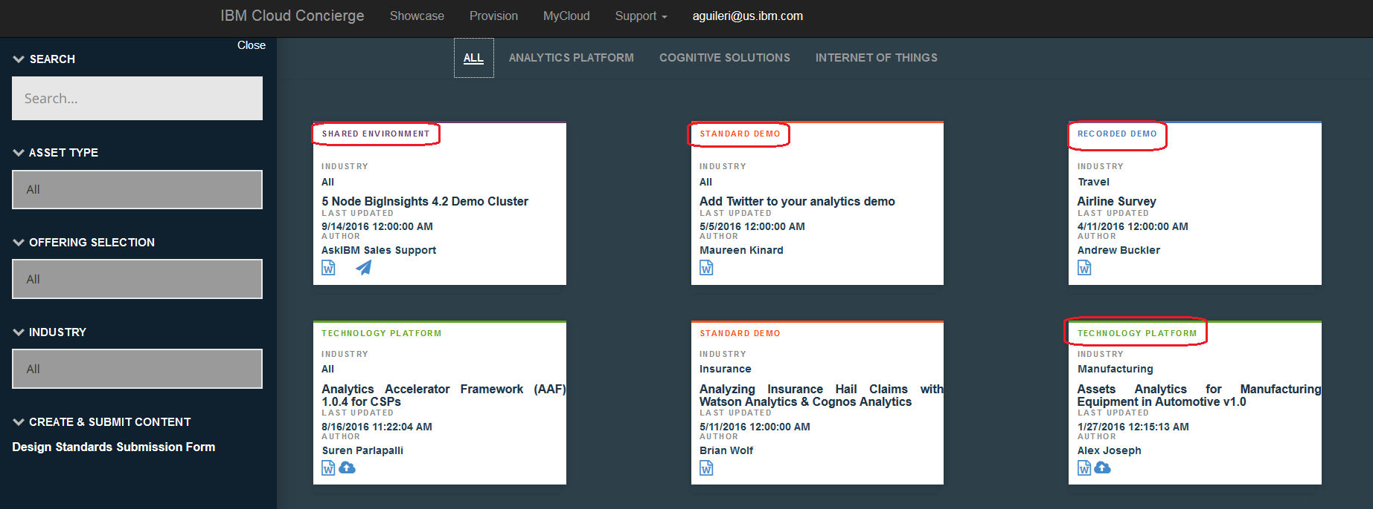
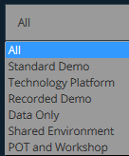
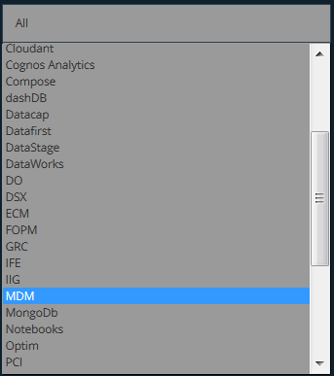
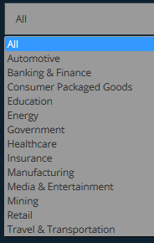
On this page you can explore by filtering the available assets by Asset Type, Industry, Brand subdivision or Offering

Slide 20

Note the different types of assets as well as the options on each one…

Slide 21
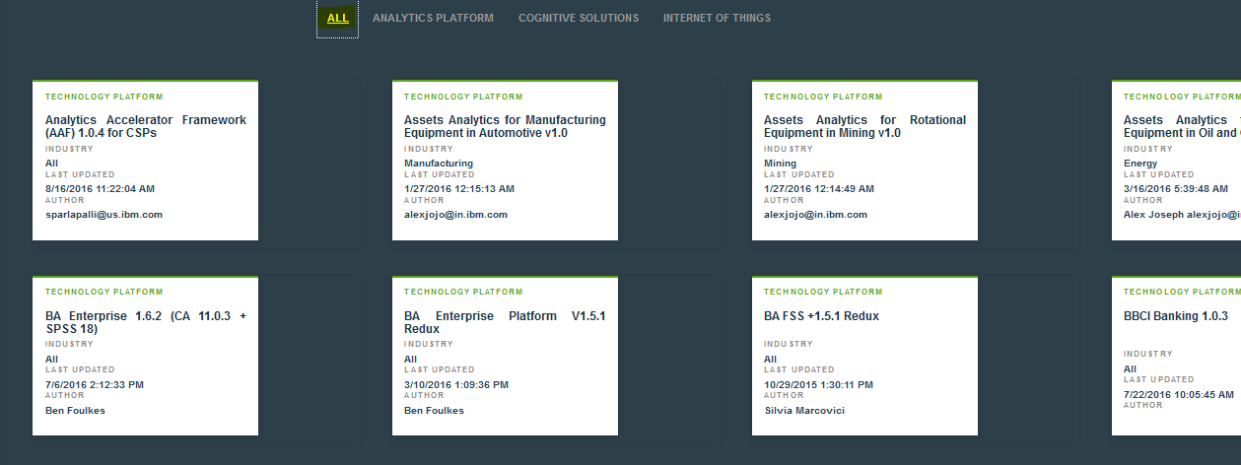
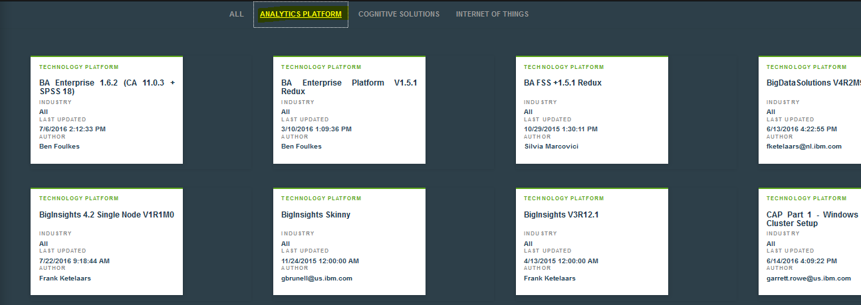
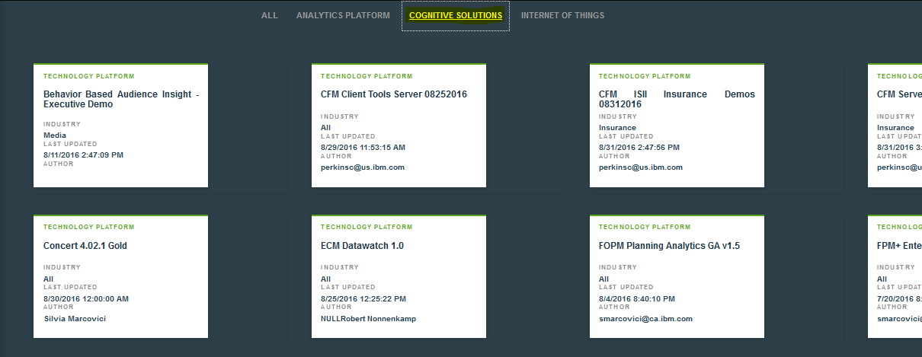
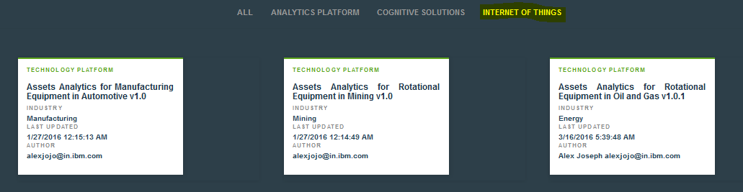
As you choose on any criteria you will notice some assets will not show as only the ones that apply are displayed…

Slide 22
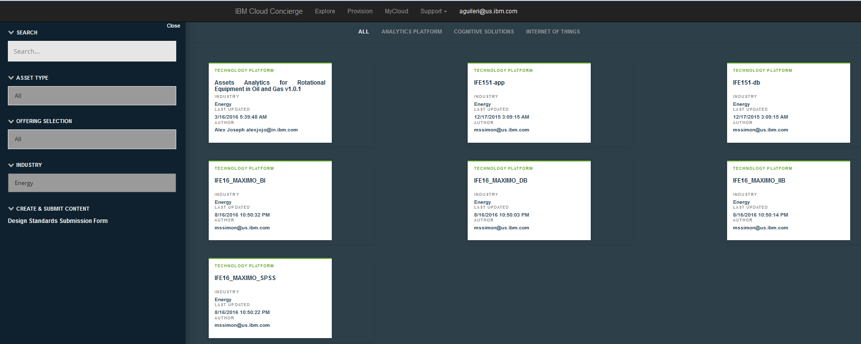
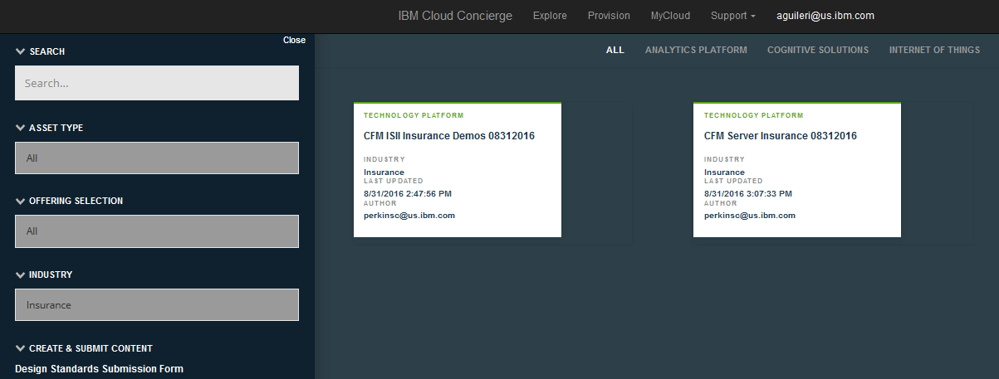
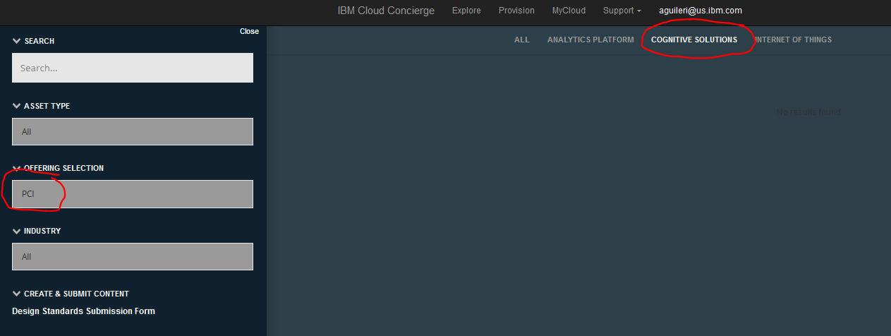
Be careful not to cross filter as it may result in no asset being shown, also, some filter items may still not have an asset associated with them
No entries because it’s an invalid combination

Slide 23
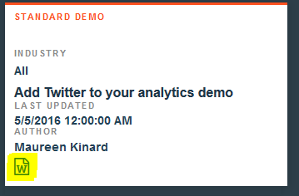
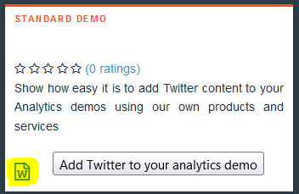
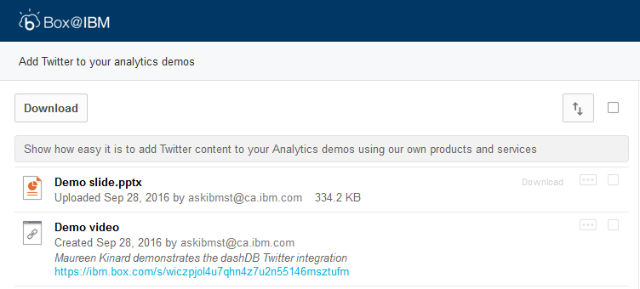
Notice the icons on each asset, as you hover over any of the displayed assets in the white boxes, the description of such asset is shown within the box
if you CLICK over the highlighted icon, you will be taken to the BOX page where all the documentation for that asset resides

Slide 24
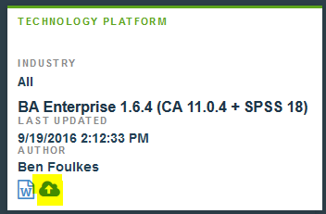
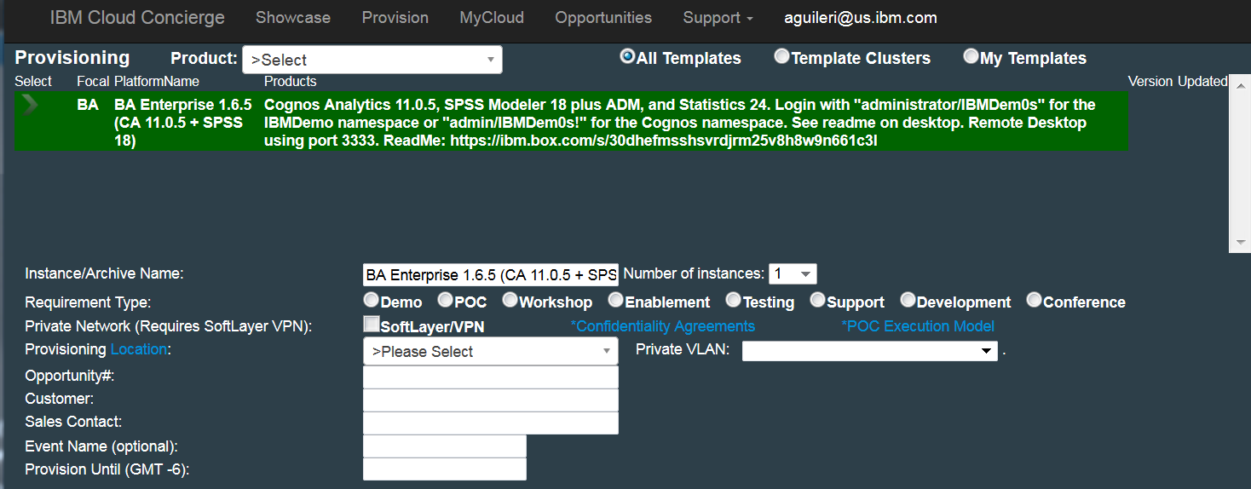
More on the icons on each asset:
If your mouse is positioned over the cloud icon and you CLICK on it you will be taken to the provisioning page directly, and that asset will be selected and highlighted for provisioning… follow the instructions on the section called “Selecting and Provisioning” later in this ppt, for finishing the process

Slide 25
Finding a known asset

Slide 26

If you already know what assets are available choose this option …

Slide 27
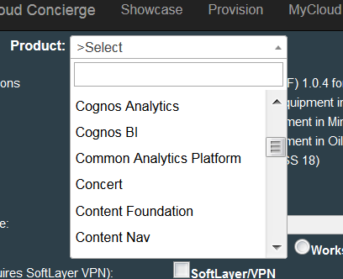
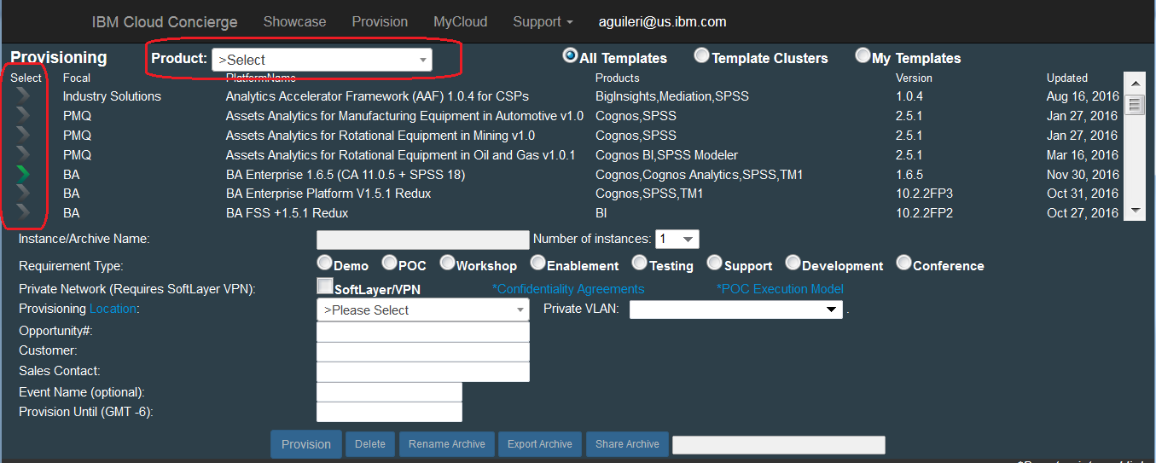
This is the provisioning interface (please note the highlighted areas below).
You must select the image by scrolling down and clicking on the “>” sign to the left of the desired image …
Or, you can filter the list of available images, by selecting the product from the drop down menu, to display only those that contain what you are looking for, as shown above.

Slide 28
Selecting and Provisioning an image

Slide 29
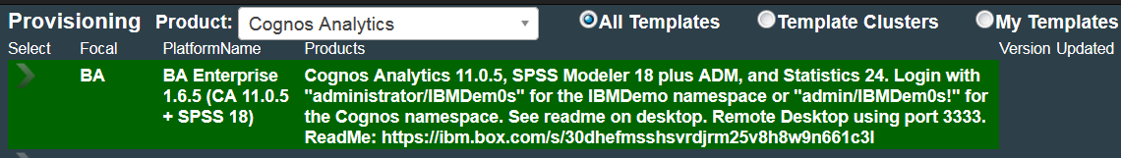
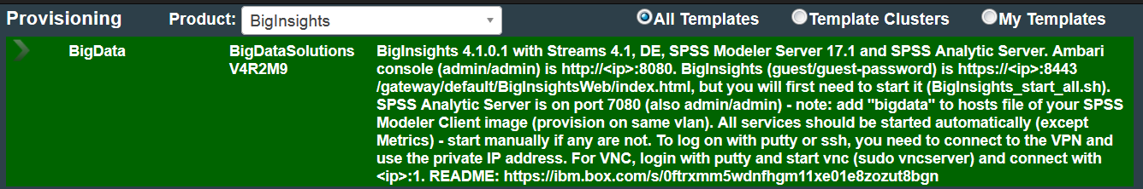
When you select an image, it will be highlighted in green and the description will be expanded, most indicate a BOX address where more info can be found, please read it thoroughly
Most images have an explanation of the contents; list of Products and installed versions, some images allow Remote Desktop (RDP) into them, some are Unix/Linux and have special instructions.

Slide 30
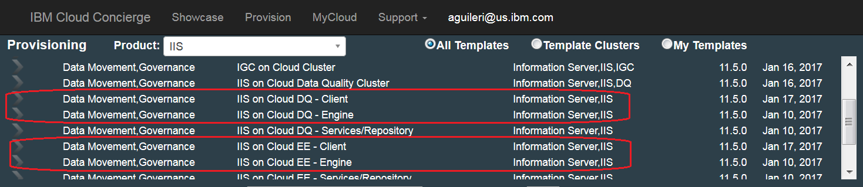
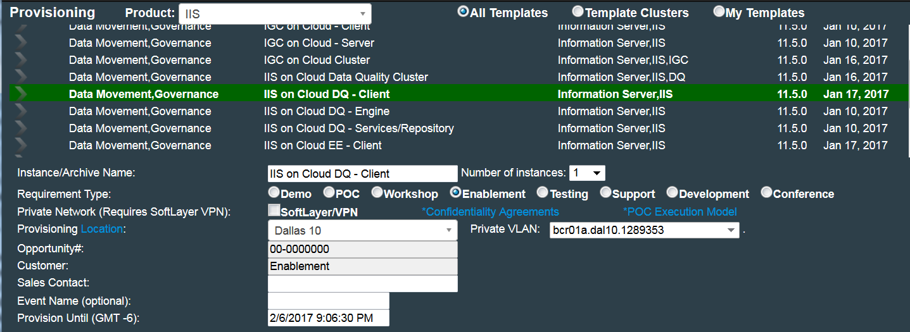
Some images have MULTIPLE parts and MUST be provisioned immediately one after the other, an example can be seen in the image below …
Select and provision each one separately

Slide 31
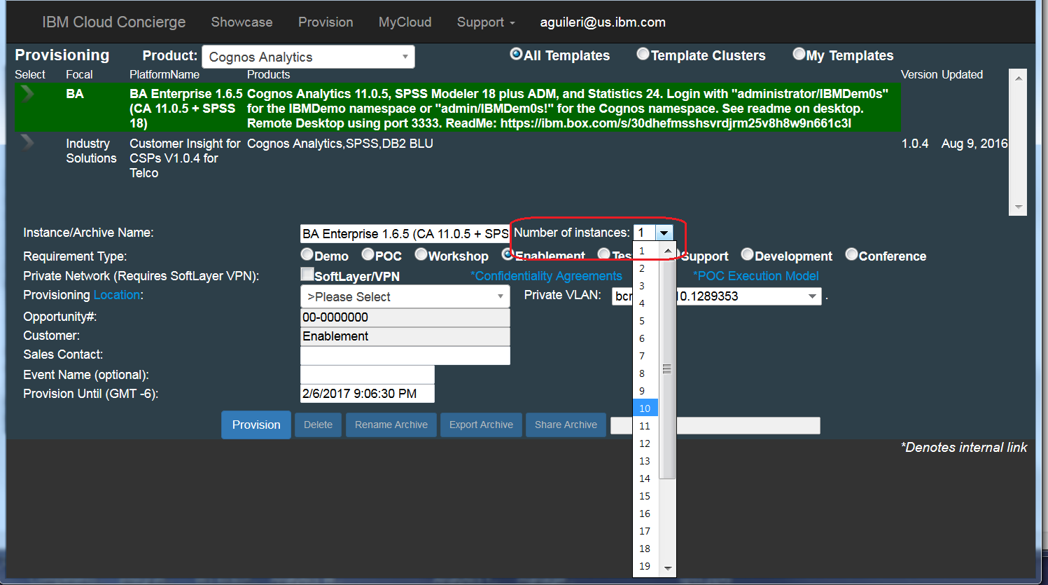
If you are planning to use an image for a workshop for several attendees, you may choose to select the “Number of instances” from the dialog shown below. This option will generate as many requests for the same image as needed, without having to request one by one.

Slide 32
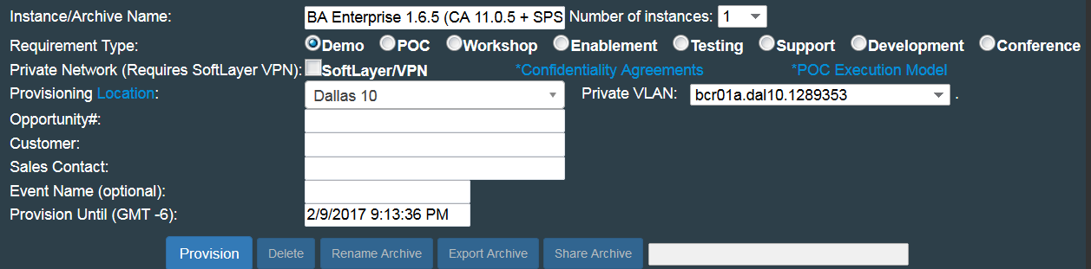
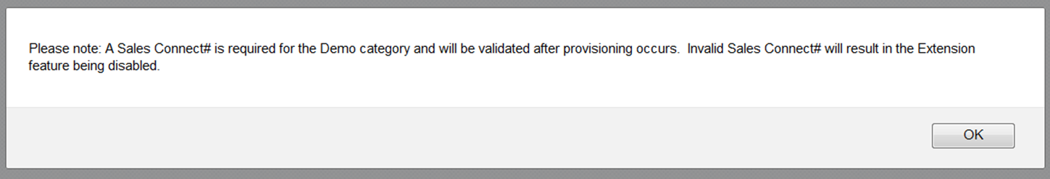
Now choose a Requirement Type, please note the different options, each one provides a DIFFERENT EXPIRY DATE (1 – 14 days) and requires you to fill different info (highlighted in yellow on the image below)
Additionally, if choosing DEMO or POC you will be REQUIRED to enter an oppty number and this number will be added to the [My opportunities] section

Slide 33
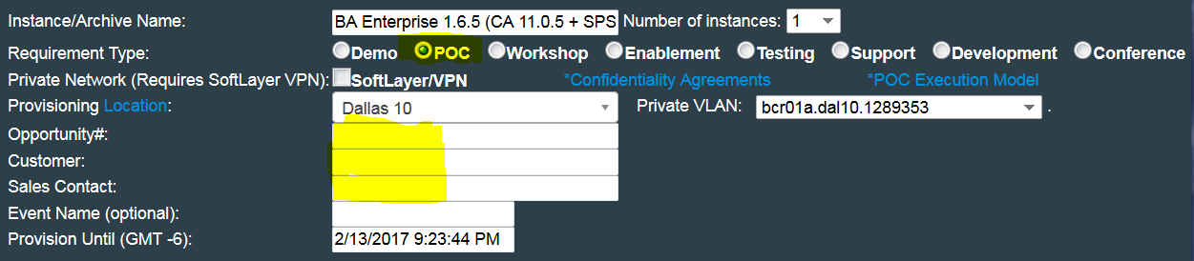
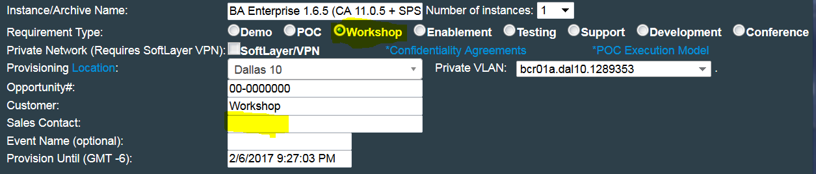
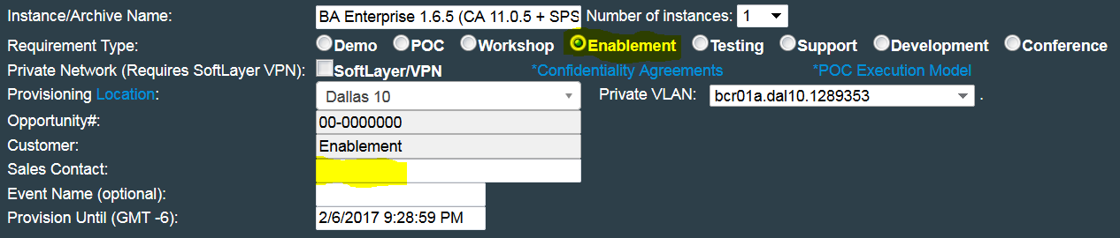
The flyout info tells you how many days you have

Slide 34
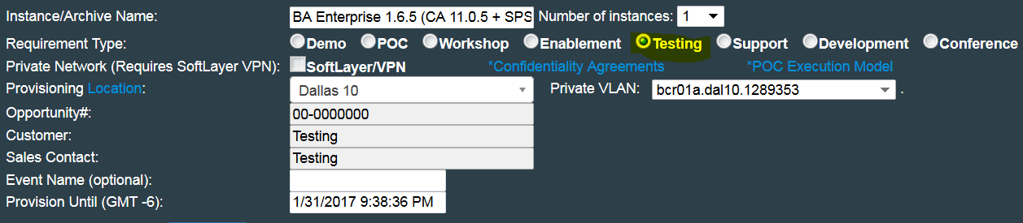
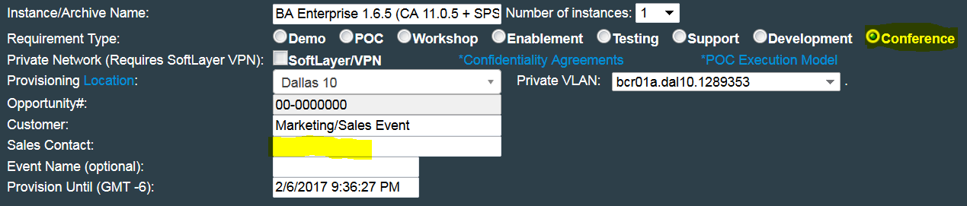
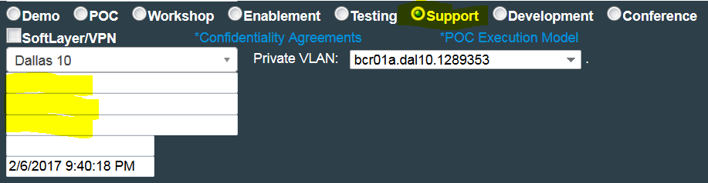
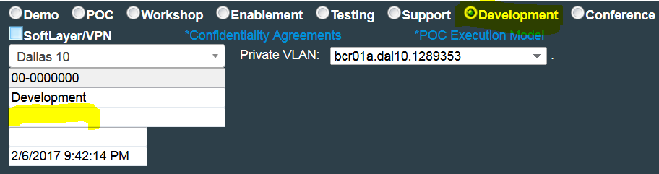
The flyout info tells you how many days you have
Please note: Support and Development requirements are only available to IBMers

Slide 35
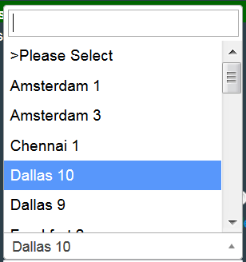
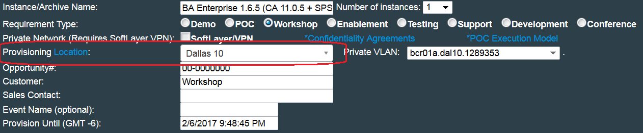
After the Requirement Type, you MUST select the SoftLayer Server that will be used to provision the environment, some images are hosted on many servers worldwide, others only on a few, please choose the SL center closest to your location, if the list is too long you can start typing and it will filter the locations

Slide 36
PLEASE NOTE that by entering a Sales Connect opportunity number you will be ALLOWED TO EXTEND the image for longer periods on your own. (please check further ahead for details)

Slide 37
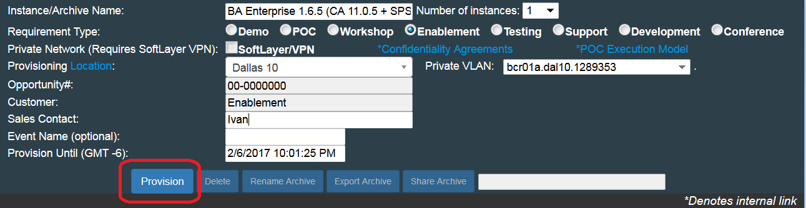
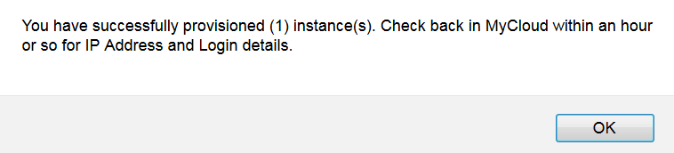

After filling up all the required options and clicking on the [Provision] button, a second browser window will pop up letting you know you have provisioned a new instance… the actual process usually takes between 30 mins to 1 hour depending on actual server load.
If using chrome, a small window will open on top of your current browser window
Click [OK] to be taken back to My Cloud page

Slide 38

Under [My Cloud], your selected image shows up highlighted in yellow, with status [Provisioning]
This page is refreshed automatically, you can close it and check back later, in any case, once the selected image is provisioned, you will receive an email with instructions on how to access it.
The selected image will then show highlighted in green or blue (for VPN), and an IP address and password will have been assigned.

Slide 39
Once your image is provisioned you will also receive an email with detailed instructions, please make sure you read and follow them

Slide 40

You will also receive an email notification when a provisioned image is about to expire …

Slide 41
If an image is provisioned with VPN

Slide 42


For more information on the use of VPN please check the video under the [Support] link
At provision time, you can also choose to add VPN access, this can prevent hackers from damaging your provisioned environment

Slide 43

If VPN protection was chosen at provisioning time, or if an image was originally created with VPN required, your image will be highlighted in BLUE. In order to be able to access it, before you can click on the generated active link or RDP/putty into it, you MUST login into the SoftLayer VPN FIRST and install and run this VPN.

Slide 44


Choose the SL VPN access server from the list, login with your user name (email address) and default password “IBMDem0s!”

Slide 45


If you need to change the SL VPN password, click on the [Manage] button shown below …
Password MUST be at least 8 digits long, MUST contain one Capital letter, one number and one special character…

Slide 46



Once you login unto SL, the process starts the installation and launches the VPN, please accept any and all installation prompts

Slide 47

At the end of the installation you will see a webpage like this, however, depending on your own network configuration, you may need to install the Standalone version for your OS

Slide 48

When you install the standalone VPN, you will see a small window show up with info from the Array SSL VPN, and there will be a red capital “A” icon on your taskbar indicating the VPN is running, you may NOW access your image.
There will be a red capital “A” showing in your taskbar when the VPN is connected correctly

Slide 49
Accessing and modifying provisioned Images

Slide 50


Opportunity numbers that you entered for a Demo or POC image you provisioned (with the need/capability to extend expiration), can be viewed under this link on the main page or the link on the Top bar …

Slide 51


Once provisioned (with or without VPN) on the cloud, depending on the image, you MAY have 2 different options to access: a- IF AVAILABLE (please read the info associated with your image) you may click directly on the name (hyperlink to the demo environment)
Clicking directly on this link will open a separate browser session. Example shown is for Cognos Analytics.
The user and password for this Demo environment is : Administrator / IBMDem0s

Slide 52



b- login into the environment by either using :
Putty (for Linux) or RDP (Windows Remote Desktop)
if they are available for the image, please check description or the email you received when the image was provisioned
please make sure you click [YES] if you get this type of warning message when you fill the login window

Slide 53

When you RDP into the Hosted demo, you are placed inside the actual OS of the Virtual machine… there are images with Win2012 or Linux (must use Putty to get into a Linux image)
From here you can start or turn off any server component or service, copy files from your own Computer into this Image or extract a demo package you may have created inside this machine to use it on other Computer or save it as backup, remember all content will be lost when the provisioned demo image expires. Be sure to backup or Archive your image.

Slide 54

Possible actions on a provisioned image :
Info: to change oppty info and what the image is being used for.
Delete: if you no longer need it, and don’t want to wait for regular expiration.
Archive: don't want to lose your work? Archive your server and later provision from where you left off. Personal Archives never expire as long as they are being used at least once a month.(see more on next slide)
Transfer: to change the owner to a co-worker for example (must also have a CC account) it will appear under [My Cloud] on his account.

Slide 55


More info on ARCHIVE action :
In order to save a copy of your working image, choose to [Archive] it BEFORE it expires, so you don’t loose any work you may have done in it.
Just select the image you wish to archive and choose the [Archive] button as shown.
You will be presented with this message indicating you have done so.

Slide 56

Also, the image will be added to the list of images you can provision, please note you can only have 1 image archived at any given period. Please contact askibmst@ca.ibm.com if you need assistance or need more than 1 image.
To access your archived image for re-provisioning, select [My Templates] from the dialog below, the archives will appear highlighted in blue and with the word CUSTOM under products.
Personal Archives never expire as long as they are being used at least once a month, however, they will expire after 60 days of non usage.
You will NOT be notified of the expiration of an Archived Image.

Slide 57


Possible actions on a provisioned image :
Rename: to provide a more meaningful name for the instance
Reboot : in case the image becomes frozen or otherwise unresponsive
Power Off (self explanatory)
Extend please see next page for extension options …
Share

Slide 58
Possible options for extension of expiry dates on images
Extend
1- add one more day if your instance is about to expire, contact askibmst@ca.ibm.com for longer extensions … or …
2- IF your image information contains a SALES CONNECT OPPTY number, and that opportunity is STILL OPEN, you will AUTOMATICALLY GET TWO WEEKS extension, you MUST add the SC# in ADVANCE, DO NOT wait until your image is expiring as process checks this overnight.

Slide 59


By default, any hosted active demonstration will be de-provisioned when its date and time have expired as stated under “Provision Until”. The expiring image will be highlighted in red as shown in the image below, you will also receive an email alert.
If you choose to DELETE an image you no longer need, the image will be highlighted in GRAY as shown below.

Slide 60
General Information

Slide 61


Most images have documentation easily accessible by clicking on the icon to the far right of the image you wish to learn more about.
Information is stored in a BOX account accessible to all authorized users

Slide 62


Demo documentation is available and easily accessible by choosing [Demo Documentation] from the Support pull down

Slide 63


Feel free to share your thoughts so that we can improve this offering… you may also post questions that may be answered by other current users who have similar experiences or by the IBM team.

Slide 64


Please check the Latest News and Updates by accessing the link shown on the image below …

Slide 65
This section applies to IBM employees ONLY

Slide 66

What happens if you have a presentation and an internet connection is NOT possible? Do you have a backup plan?
(other than drawing pretty pictures on a whiteboard….)

Slide 67

Get in contact with the askibm team and request the document shown below, this is NOT available for partners

Slide 68


